Slide 1
Presentation on Snake Ladder Game
Presented By
[Sheikh Muhammad Samir Hoda] [THA081BCT036]
[Shishir Shrestha] [THA081BCT038]
[Prasiddha Adhikari] [THA081BCT021]
[Shivam Kumar Sah] [THA081BCT039]
Submitted to:
Department of Electronics and Computer Engineering
Thapathali Campus
Kathmandu, Nepal
21st March 2025

Slide 2
Introduction
Game
A game is an interactive activity with rules, goals and challenges designed for entertainment, learning, or competition.
Snake ladder Game
Classic Board Game – Snake and Ladder is a popular board game played between two or more players, where the goal is to reach the final square by rolling a die.
Snakes and Ladders Mechanism – Landing on a ladder moves the player up, while landing on a snake sends them down, adding an element of luck to the game.

Slide 3
Cont…
Modern Adaptations – The game has been adapted into digital versions, mobile apps, and multiplayer online games, making it accessible to a wider audience.

Slide 4
History
Ancient Indian Origins – Snake and Ladder, originally known as Moksha Patam, was created in ancient India as a moral teaching tool, representing virtues (ladders) and vices (snakes).
Spiritual Symbolism – The game was designed to teach karma, destiny, and the path to enlightenment, where good deeds helped players ascend, and bad deeds caused them to fall.
Spread to Britain – During the British colonial period, the game was taken to England in the late 19th century, where it was modified and renamed "Snakes and Ladders."

Slide 5
Objectives
A snake ladder game using c
Game logic implementation
Data management
User interaction
Code Maintainability
Future Enhancements

Slide 6
Features of the Game
Multiplayer support (2 or more players)
Random dice rolls for fairness
Ladders to boost progress
Snakes to challenge players
Unlocking dice mechanism
When one player reach to 100 then remaining can continue play.

Slide 7
How the Game Works?
Players enter their names and number of participants.
Each player rolls the dice (random number from 1-6).
Players move forward based on the dice roll.
Position of player denote by P1, P2 , P3……
Different colors are used to denote the positions of different players.

Slide 8
Cont…
If multiple player at the same posiiton then denote by #number of player#.
Ladders help players climb up.
Snakes push players down.
The first player to reach 100 wins

Slide 9
Special Rules
Players must roll a 1 to unlock their dice.
If a player exceeds 100, their move is canceled.
Special positions for snakes 🐍 and ladders affect movement:
Ladder | Moves up to
12 | 34
24 | 46
45 | 67
56 | 68
76 | 87
85 | 91

Slide 10
Cont…
Snake | Moves Down to
99 | 84
18 | 4
78 | 64
35 | 18
49 | 28
24 | 8

Slide 11
Game Board Representation
Uses a 2D representation with numbered squares.
Special positions for snakes & ladders.
Players' positions stored in an array.
Each player is represented with a unique color code.
Snakes (S) and Ladders (L) are marked for visibility.
Two different color for snake and ladder.
Specify the ending and starting point of snake and ladder.

Slide 12
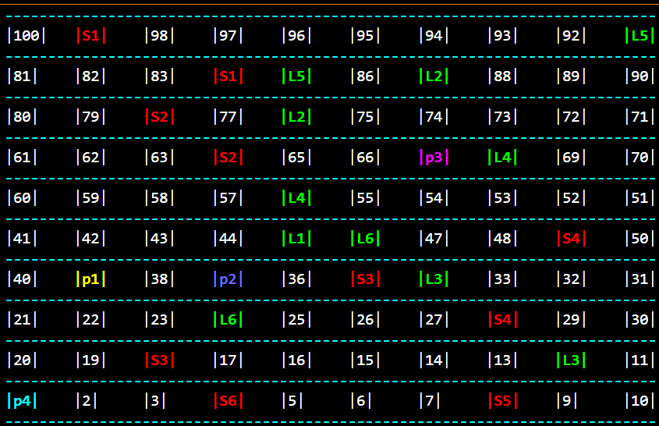
Interface
This is how our game interface looks when all four players are in the game.

Slide 13
Challenges Faced
Handling player turns efficiently
Preventing infinite loops in the game logic
Using different color for representing different player.
Denoting the position of player, snake and ladder

Slide 14
Conclusion
A simple yet engaging game built in C.
Showcases loops, conditions, and functions effectively.
A great way to learn game logic implementation!
Future enhancements could include a GUI version!

Slide 15
Thank You!!!!
ANY QUESTIONS????

